Slide 1
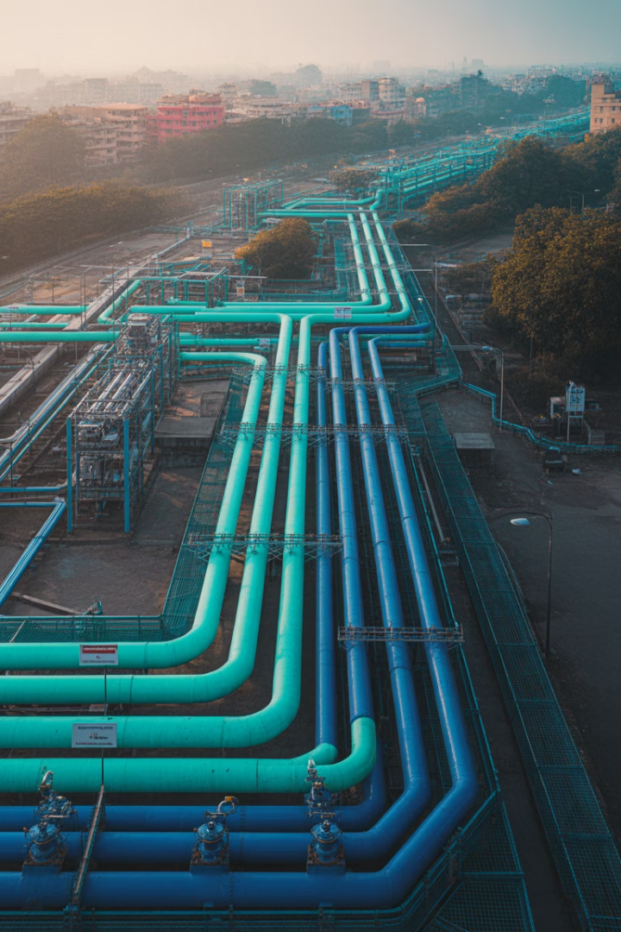

City Gas Distribution (CGD) Network in India by IOCL
A comprehensive overview of Indian Oil Corporation Limited's role in developing and expanding city gas distribution networks across India.
by Parijat Chakraborty

Slide 2

Introduction
CGD Sector Overview
Natural Gas Importance
IOCL's Role
IOCL leads energy infrastructure development with strategic investments.
India's CGD sector is rapidly expanding to meet growing energy demands.
Natural gas forms a crucial part of India's cleaner energy transition.

Slide 3
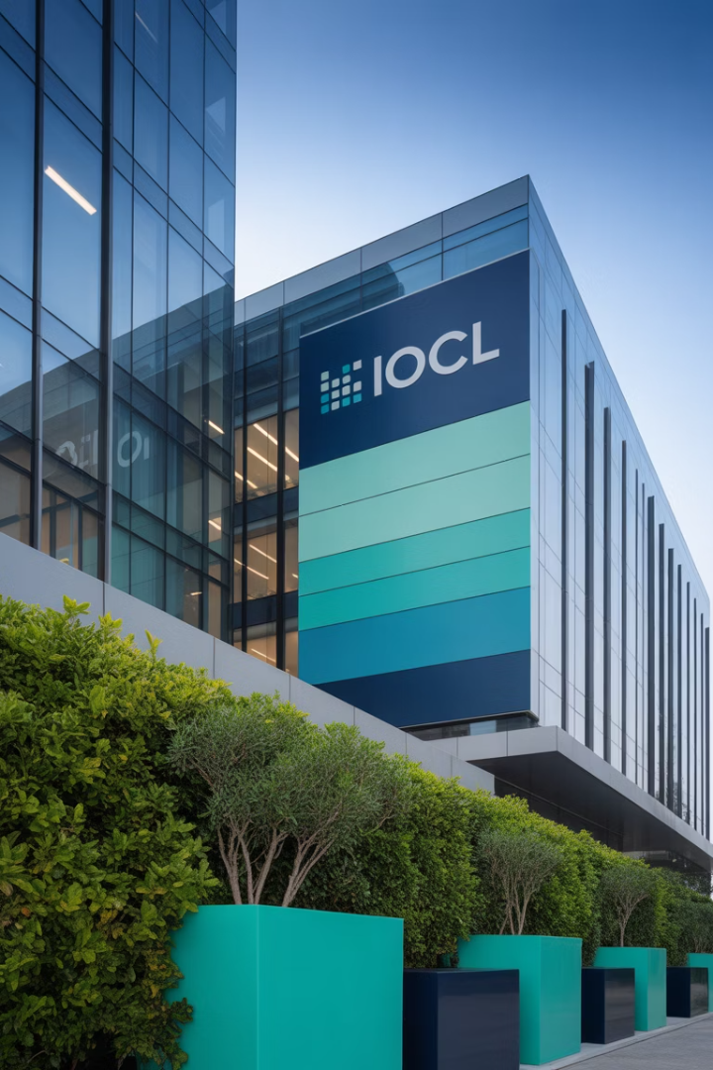
About Indian Oil Corporation Limited (IOCL)
1
Founding
Established as a public sector undertaking, serving India's energy needs.
2
Market Presence
Strong domestic footprint with growing global operations.
3
Diverse Portfolio
Spans oil, gas, petrochemicals, renewables, pipelines, and R&D.
4
Strategic Focus
Committed to diversification and sustainability initiatives.

Slide 4



What is City Gas Distribution (CGD)?
End Users
1
Households, industries, and transport sectors
Distribution Network
2
CNG stations and pressure regulating stations
Infrastructure
3
Pipeline networks for safe gas transport

Slide 5




India's CGD Landscape
Coverage
Key Players
Authorized areas span multiple states and union territories.
PNGRB Regulation
IOCL, GAIL, Adani Gas, Gujarat Gas, and Torrent Gas.
Oversees licensing and operations of all CGD networks.
Expansion
Rapidly growing to cover more geographical areas.
2
3
1
4

Slide 6
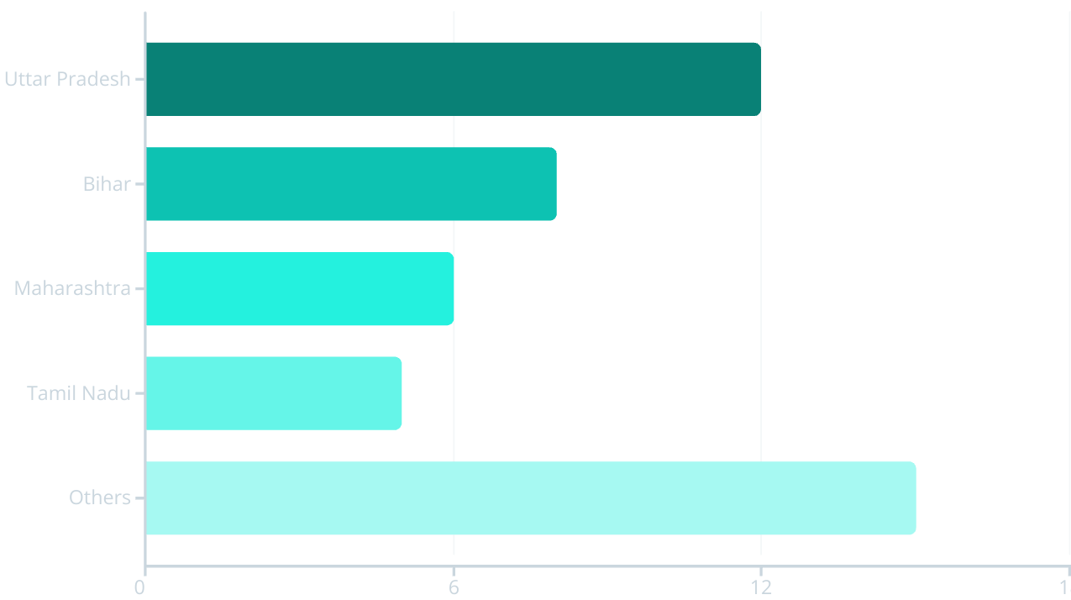
IOCL's CGD Projects
IOCL has secured numerous Geographical Areas through PNGRB bid rounds. The company maintains a strong market position among competitors.

Slide 7
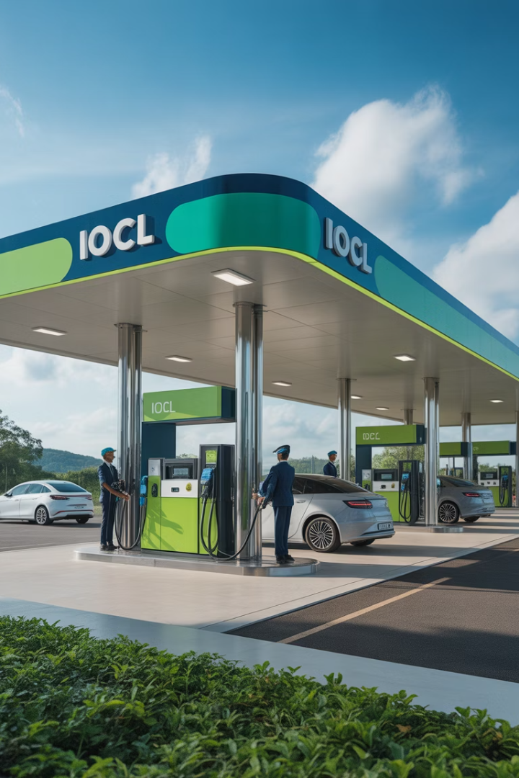
Infrastructure & Technology
Pipeline Networks
Extensive steel and PE pipeline infrastructure for reliable gas delivery.
Fueling Stations
Modern CNG stations and LNG fueling points across service areas.
Monitoring Systems
Advanced SCADA, GIS, and real-time monitoring for operational excellence.
Clean Technologies
Adoption of efficient, environmentally friendly technological solutions.

Slide 8




Business Model & Partnerships
Capital Investment
Strategic funding for long-term infrastructure development.
Public-Private Partnerships
Collaborative ventures to enhance market reach.
Strategic Alliances
Partnerships with municipal bodies and technology providers.

Slide 9
Environmental & Economic Impact
Environmental Benefits
Economic Advantages
Supports India's net-zero vision
Creates skilled employment opportunities
Reduces greenhouse gas emissions
Offers cost savings for consumers
Improves urban air quality
Enhances industrial competitiveness
Aligns with Paris Agreement goals
Reduces import dependency

Slide 10
Challenges & Opportunities
Supply Chain Issues
1
Sourcing, LNG imports, and storage logistics
Demand Potential
2
Expanding domestic, industrial, and transport markets
Government Policies
3
Pricing, subsidies, and regulatory frameworks
Innovation Opportunities
4
New bid rounds and green hydrogen integration

Slide 11

Future Roadmap
Future Innovations
Energy Transition Alignment
Bio-CNG, hydrogen blending, and smart metering technologies.
Geographical Expansion
Strategic Vision
Supporting India's net-zero commitments through cleaner fuels.
IOCL's long-term plan for CGD market leadership and innovation.
Planned entry into new areas through upcoming PNGRB bid rounds.

Slide 12


Conclusion & Call to Action
Key Takeaways
CGD networks are transforming India's energy landscape.
Stakeholder Recommendations
Opportunities for policymakers and investors to engage.
Collaboration Opportunities
Partner with IOCL for CGD development and innovation.

Slide 13
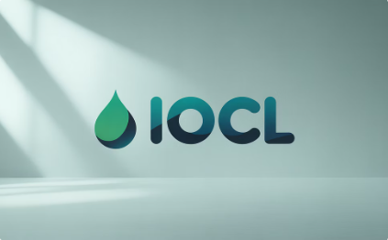
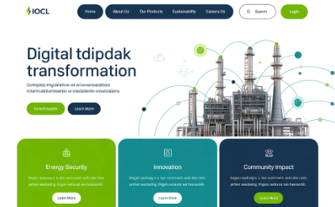

Thank You
Contact Us
Email: cgd@iocl.in | Phone: +91-11-XXXXXXXX
Website
www.iocl.com/cgd
Our Team
Thank you to the IOCL CGD team and all our partners.

Slide 14

Introduction
70%
400+
33M
Energy Mix Target
Geographical Areas
Household Connections
India aims to increase natural gas in energy mix from 6% to 15%.
CGD networks authorized across India's diverse regions.
Target for PNG connections by 2030.

Slide 15
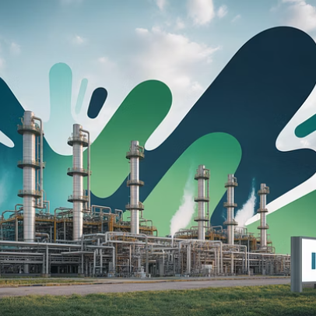
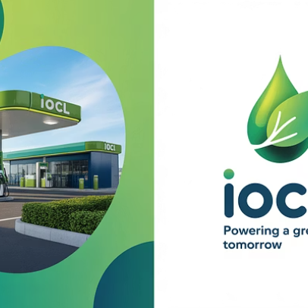


About Indian Oil Corporation Limited (IOCL)
IOCL's diverse operations span the entire energy value chain. The company maintains leadership in traditional fuels while expanding into future energy solutions.

Slide 16




What is City Gas Distribution (CGD)?
Gas Source
Transmission
Natural gas from domestic fields or imported LNG
1
High-pressure pipelines transport gas to city gates
2
Consumption
4
Distribution
Utilized by households, vehicles, and industries
3
Medium and low-pressure networks reach end users

Slide 17
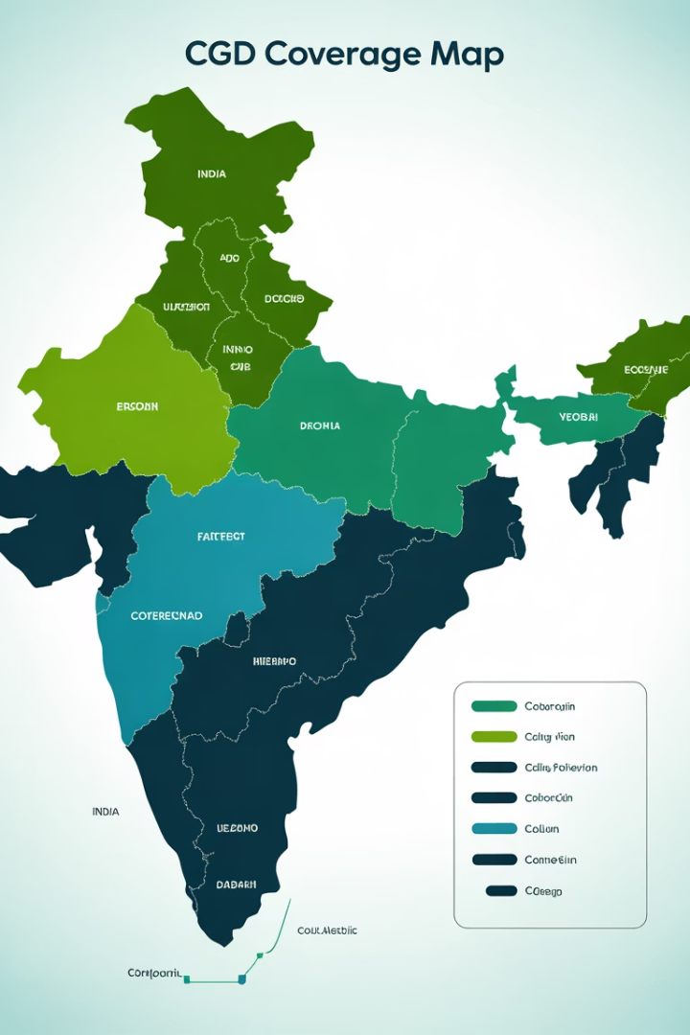
India's CGD Landscape
Bid Round
Year
GAs Awarded
Population Coverage
9th
2018
86
26%
10th
2019
50
24%
11th
2021
65
20%
PNGRB has significantly expanded CGD coverage through successive bid rounds. Major players compete for strategic geographical areas.

Slide 18
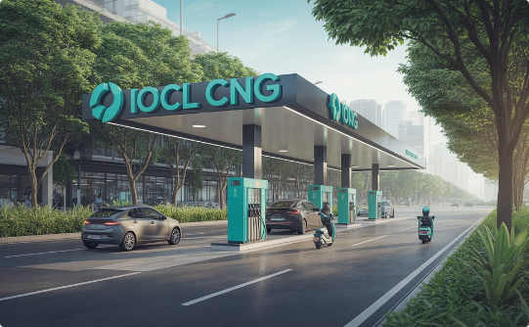
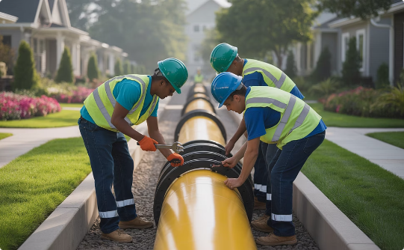
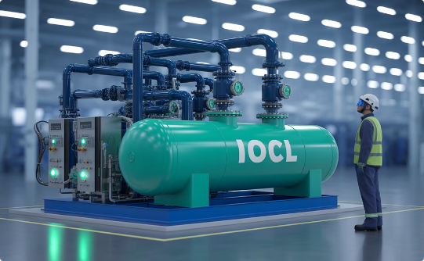
IOCL's CGD Projects
CNG Infrastructure
PNG Networks
Industrial Supply
Modern stations serving transport sector needs across multiple states.
Expanding household connections in key geographical areas.
Reliable gas delivery to commercial and industrial customers.

Slide 19

Infrastructure & Technology
Pipeline Networks
Steel pipelines for high pressure. PE pipes for distribution networks.
CNG Stations
Modern compression and dispensing technology for vehicle refueling.
SCADA Systems
Real-time monitoring and control of entire network operations.
GIS Mapping
Precise geographical information systems for network management.

Slide 20
Thank You
Contact Information
Acknowledgments
Email: cgd@iocl.in
We thank the IOCL team, our partners, and you for your attention.
Phone: +91-11-XXXXXXXX
We welcome your questions and feedback on our CGD initiatives.
Website: www.iocl.com/cgd

